Slide 1
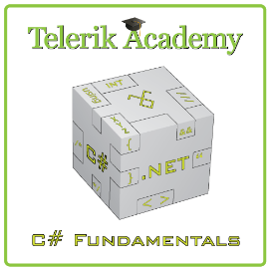
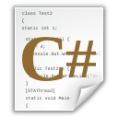


C# Part II – Course Intro
http://csharpfundamentals.telerik.com
Course Program, Evaluation and Exams
Svetlin Nakov
Technical Trainer
www.nakov.com
Telerik Software Academy
academy.telerik.com

Slide 2

Table of Contents
What's Coming Next in the Academy?
The C# Part II Course Program
The Trainers Team
Exams and Evaluation
Standard Criteria
Bonuses
Resources for the Course
Champions from C# Part I

Slide 3
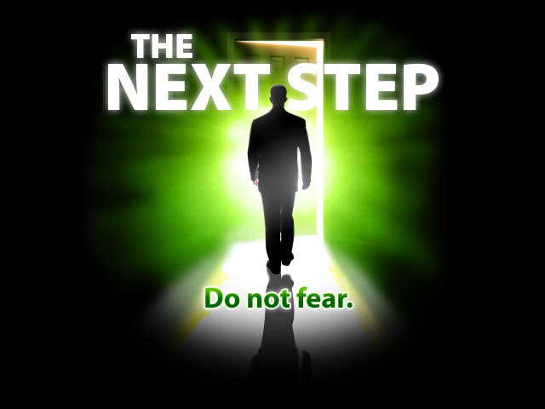
C# Fundamentals – Part II
Coming To The Next Module

Slide 4

What's Coming Next?
C# Part II
Continuation of C# – Part I
Fundamentals of programming
Pretty much the same
Lectures one time a week
Practical exam after two months
The course exam?
5 problems for 6 hours
http://bgcoder.com

Slide 5
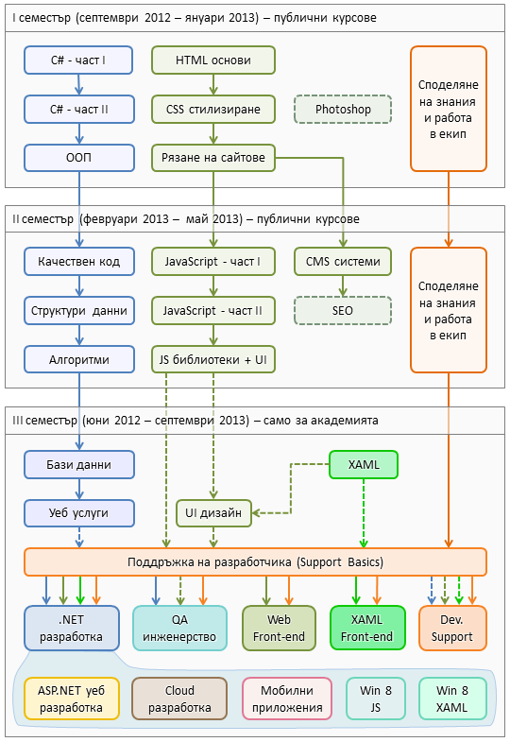
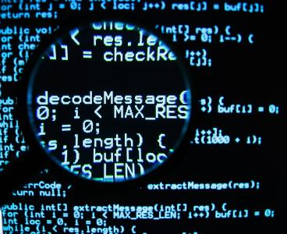
C# Programming Track
Software Academy curriculum
The C# Programming Track
The Web Development Track
Specialties @ the Academy
Success Stories @ Telerik

Slide 6
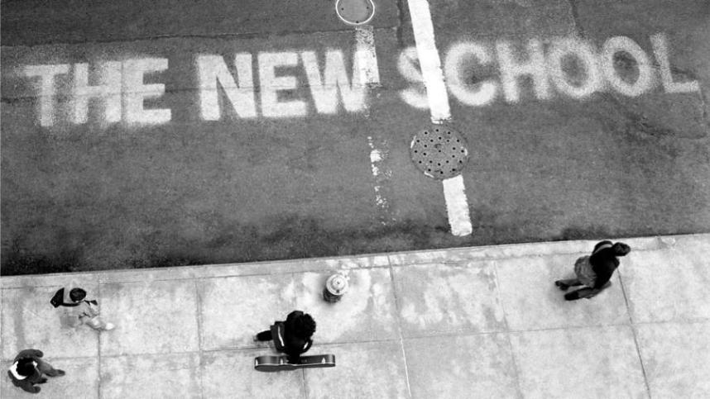
C# Part II – Program
What Will We Cover in C# Part II?

Slide 7
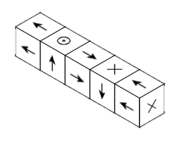
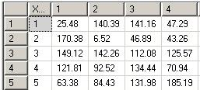

The C# II Course Program
Arrays
Working with arrays
Algorithms on sequences
Multidimensional Arrays
Matrices, cubes etc.
Algorithms on matrices
Methods
Creating and calling methods
Return type, arguments, overloading

Slide 8
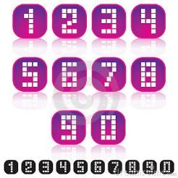


The C# II Course Program (2)
Numeral Systems
Binary, decimal, hexadecimal
Representation of numbers
Creating and Using Objects
What is object?
Using .NET standard classes
Exception Handling
What are exception?
Catching and throwing exceptions

Slide 9



The C# II Course Program (3)
Strings and Text Processing
Working with strings
Building strings
Text Files
Reading and writing text files
Practical Exam Preparation
Solving the last year's problems
Practical Exam
5 problems for 6 hours

Slide 10
Saturday Workshops
Arrays and Multidimensional arrays (13.07)
Methods and Numeral systems (20.07)
Creating a game (27.07)
Using classes and objects (03.08)
Exception handling and Text files (10.08)
String and text processing (17.08)
Exam preparation (until exam day)

Slide 11
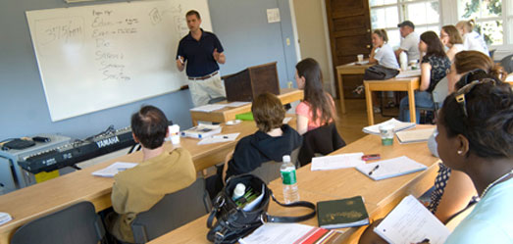
The Trainers Team

Slide 12
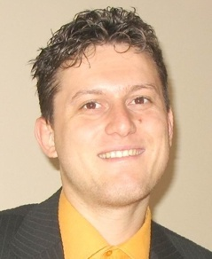
Trainers Team
Svetlin Nakov, PhD
Manager Technical Training @ Telerik Software Academy
20 years software development experience
10+ years experience as trainer
Author of 6 books
Speaker at hundreds of events
E-mail: svetlin.nakov [at] telerik.com
Web site / Blog: http://nakov.com

Slide 13
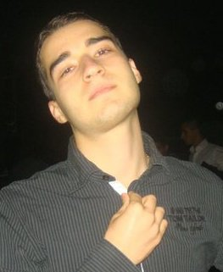
Trainers Team (2)
Nikolay Kostov
Senior Software Developer and Technical Trainer @ Telerik Corp.
Student at Sofia University
Computer Science
IT and Informatics competitions contestant
Graduate from the second season of Telerik Software Academy
Email: nikolay.kostov [at] telerik.com
Blog: http://nikolay.it

Slide 14
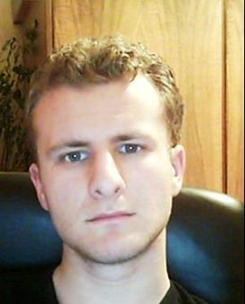
Trainers Team (3)
George Georgiev
Technical Trainer @ Telerik Corp.
Informatics and IT competitions contestant and winner
Student in Sofia University
Software engineering
Graduate from the third season of Telerik Software Academy
E-mail: georgi.georgiev [at] telerik.com
Blog: http://itgeorge.net

Slide 15
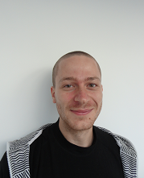
Trainers Team (4)
Ivaylo Kenov
Technical Assistant @ Telerik Corp.
Student at Telerik Academy Season 2012/2013
Mathematical competitions contestant
E-mail: ivaylo.kenov [at] telerik.com
Champion in OOP and DSA

Slide 16
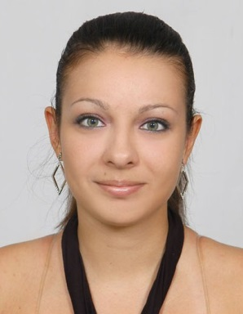
Trainers Team (5)
Penka Borukova
Currently student at Telerik Academy
Student at Sofia University
Computer Science
Used to be part of the team that started Game-Craft company
Programmer enthusiast
Email: p.borukova [at] gmail.com
Blog: http://pborukova.wordpress.com/

Slide 17
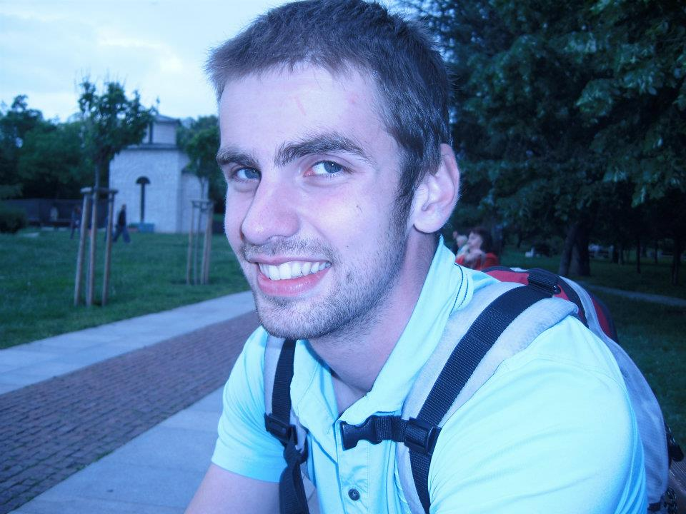
Trainers Team (6)
Subo Rusev
Student in Sofia University
Computer Science
Student from the fourth season from Telerik Academy
Plays guitar
E-mail: rusev_s [at] yahoo.com
Blog: http://rusevs.wordpress.com/

Slide 18




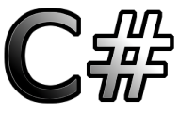
Evaluation
Thank God There Are Bonuses!

Slide 19

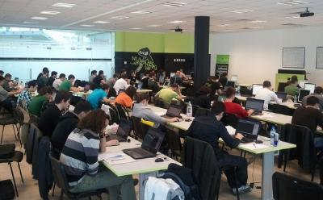
C# Part II – Evaluation
Evaluation components
Practical exam – 65%
Team work – 15%
Homework – 10%
Homework evaluation – 10%
3 peer reviews per homework
Bonuses
Forums activity – bonus up to 10%

Slide 20
Homework Peer Reviews
Everyone will get feedback for their homework
Everyone will give feedback for few random homework submissions
Students submit homework anonymously
Please exclude your name from the submissions!
For each homework submitted
Students evaluate 3 random homeworks
From the same topic, after the deadline
Give written feedback, at least 200 characters
Low-quality feedback → report for punishment

Slide 21








Resources
What We Need in Addition to this Course Content?

Slide 22

The C# Textbook
The official textbook for the course
“Introduction to Programming with C#”, Nakov S. and his team, 2010
Freely downloadable from: www.introprogramming.info
The C# programming tracks follows the book
C# Part II → chapters 7…15 (with exceptions)

Slide 23
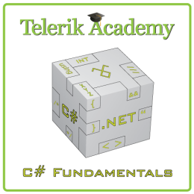
Course Web Site & Forums
Register for the "Telerik Academy Forums":
Discuss the course exercises with your colleagues
Find solutions for the exercises
Share source code / discuss ideas
The C# Part II official web site:
forums.academy.telerik.com/csharp-fundamentals
http://academy.telerik.com/student-courses/ programming/csharp-programming-part-2/

Slide 24
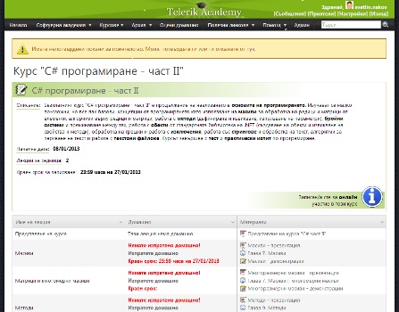
Telerik Integrated Learning System (TILS)
The Telerik Integrated Learning System (TILS)
www.telerikacademy.com
Important resource for all students
Homework submissions
Homework peer reviews
Presence cards with barcode
Reports about your results
telerikacademy.com/Courses/Courses/Details/97

Slide 25


Required Software
Software needed for this course:
Microsoft Windows (XP / Win7 / Win8)
Microsoft Visual Studio 2012 or Visual Studio Express 2012 (free version of VS 2012)
.NET Framework 4.5 (included in Visual Studio)
Visual Studio 2005, 2008 or 2010 is also OK

Slide 26


Champions of the First Part
Telerik Academy Ninja Champions

Slide 27



Champions: C# Part I
# 1 – Martin Nikolov
# 2 – Jivko Pavlovski
# 3 – Stefan Mirevski
# 4 – Desislava Panayotova
# 5 – Stefan Varbanov

Slide 28
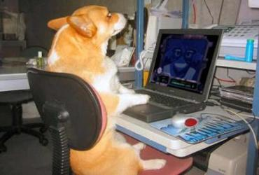
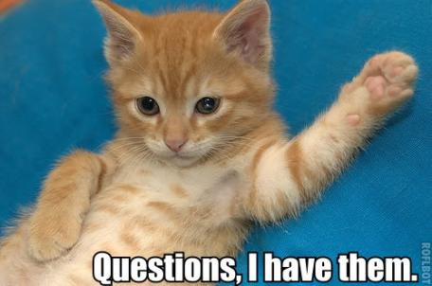

C# Fundamentals – Part II Introduction
http://academy.telerik.com

Slide 29
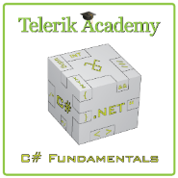



Free Trainings @ Telerik Academy
C# Programming @ Telerik Academy
csharpfundamentals.telerik.com
Telerik Software Academy
academy.telerik.com
Telerik Academy @ Facebook
facebook.com/TelerikAcademy
Telerik Software Academy Forums
forums.academy.telerik.com

